Slide 1
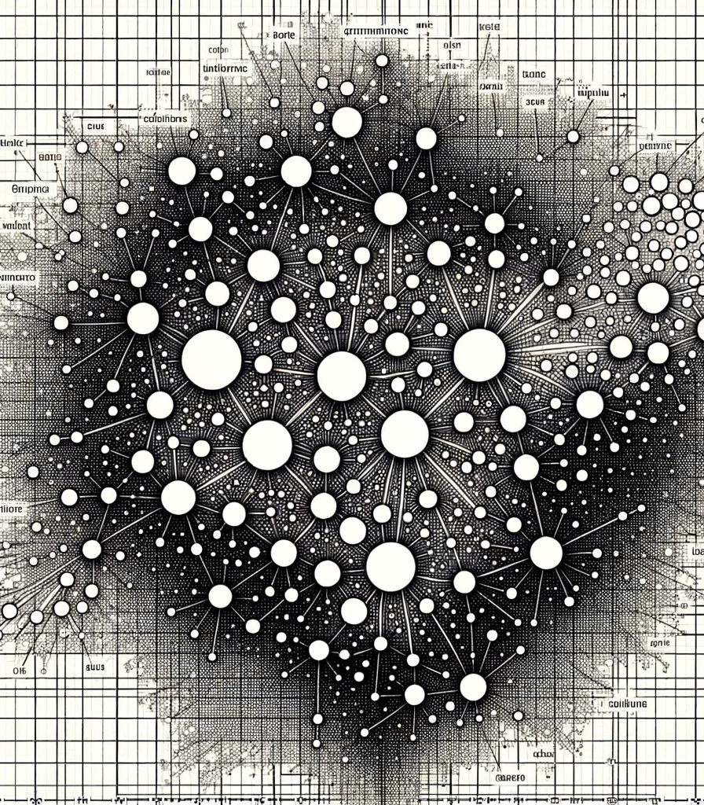
Comparison of Strategies to Inform K-means Clustering
Chris Taylor
DTSA 5510

Slide 2

Frame the Problem
K-means requires selection of k before implementing the algorithm
Two popular methods for selecting k
Elbow Plot
“Coarse” according to Géron (2021)
Silhouette Score
How does the use of each impact the output of the algorithm?

Slide 3
Exploratory Data Analysis

Slide 4

Description of Data
210 observations
Eight geometric properties
Area
Perimeter
Compactness
Kernel length
Kernel width
Asymmetry coefficient
Kernel groove length

Slide 5
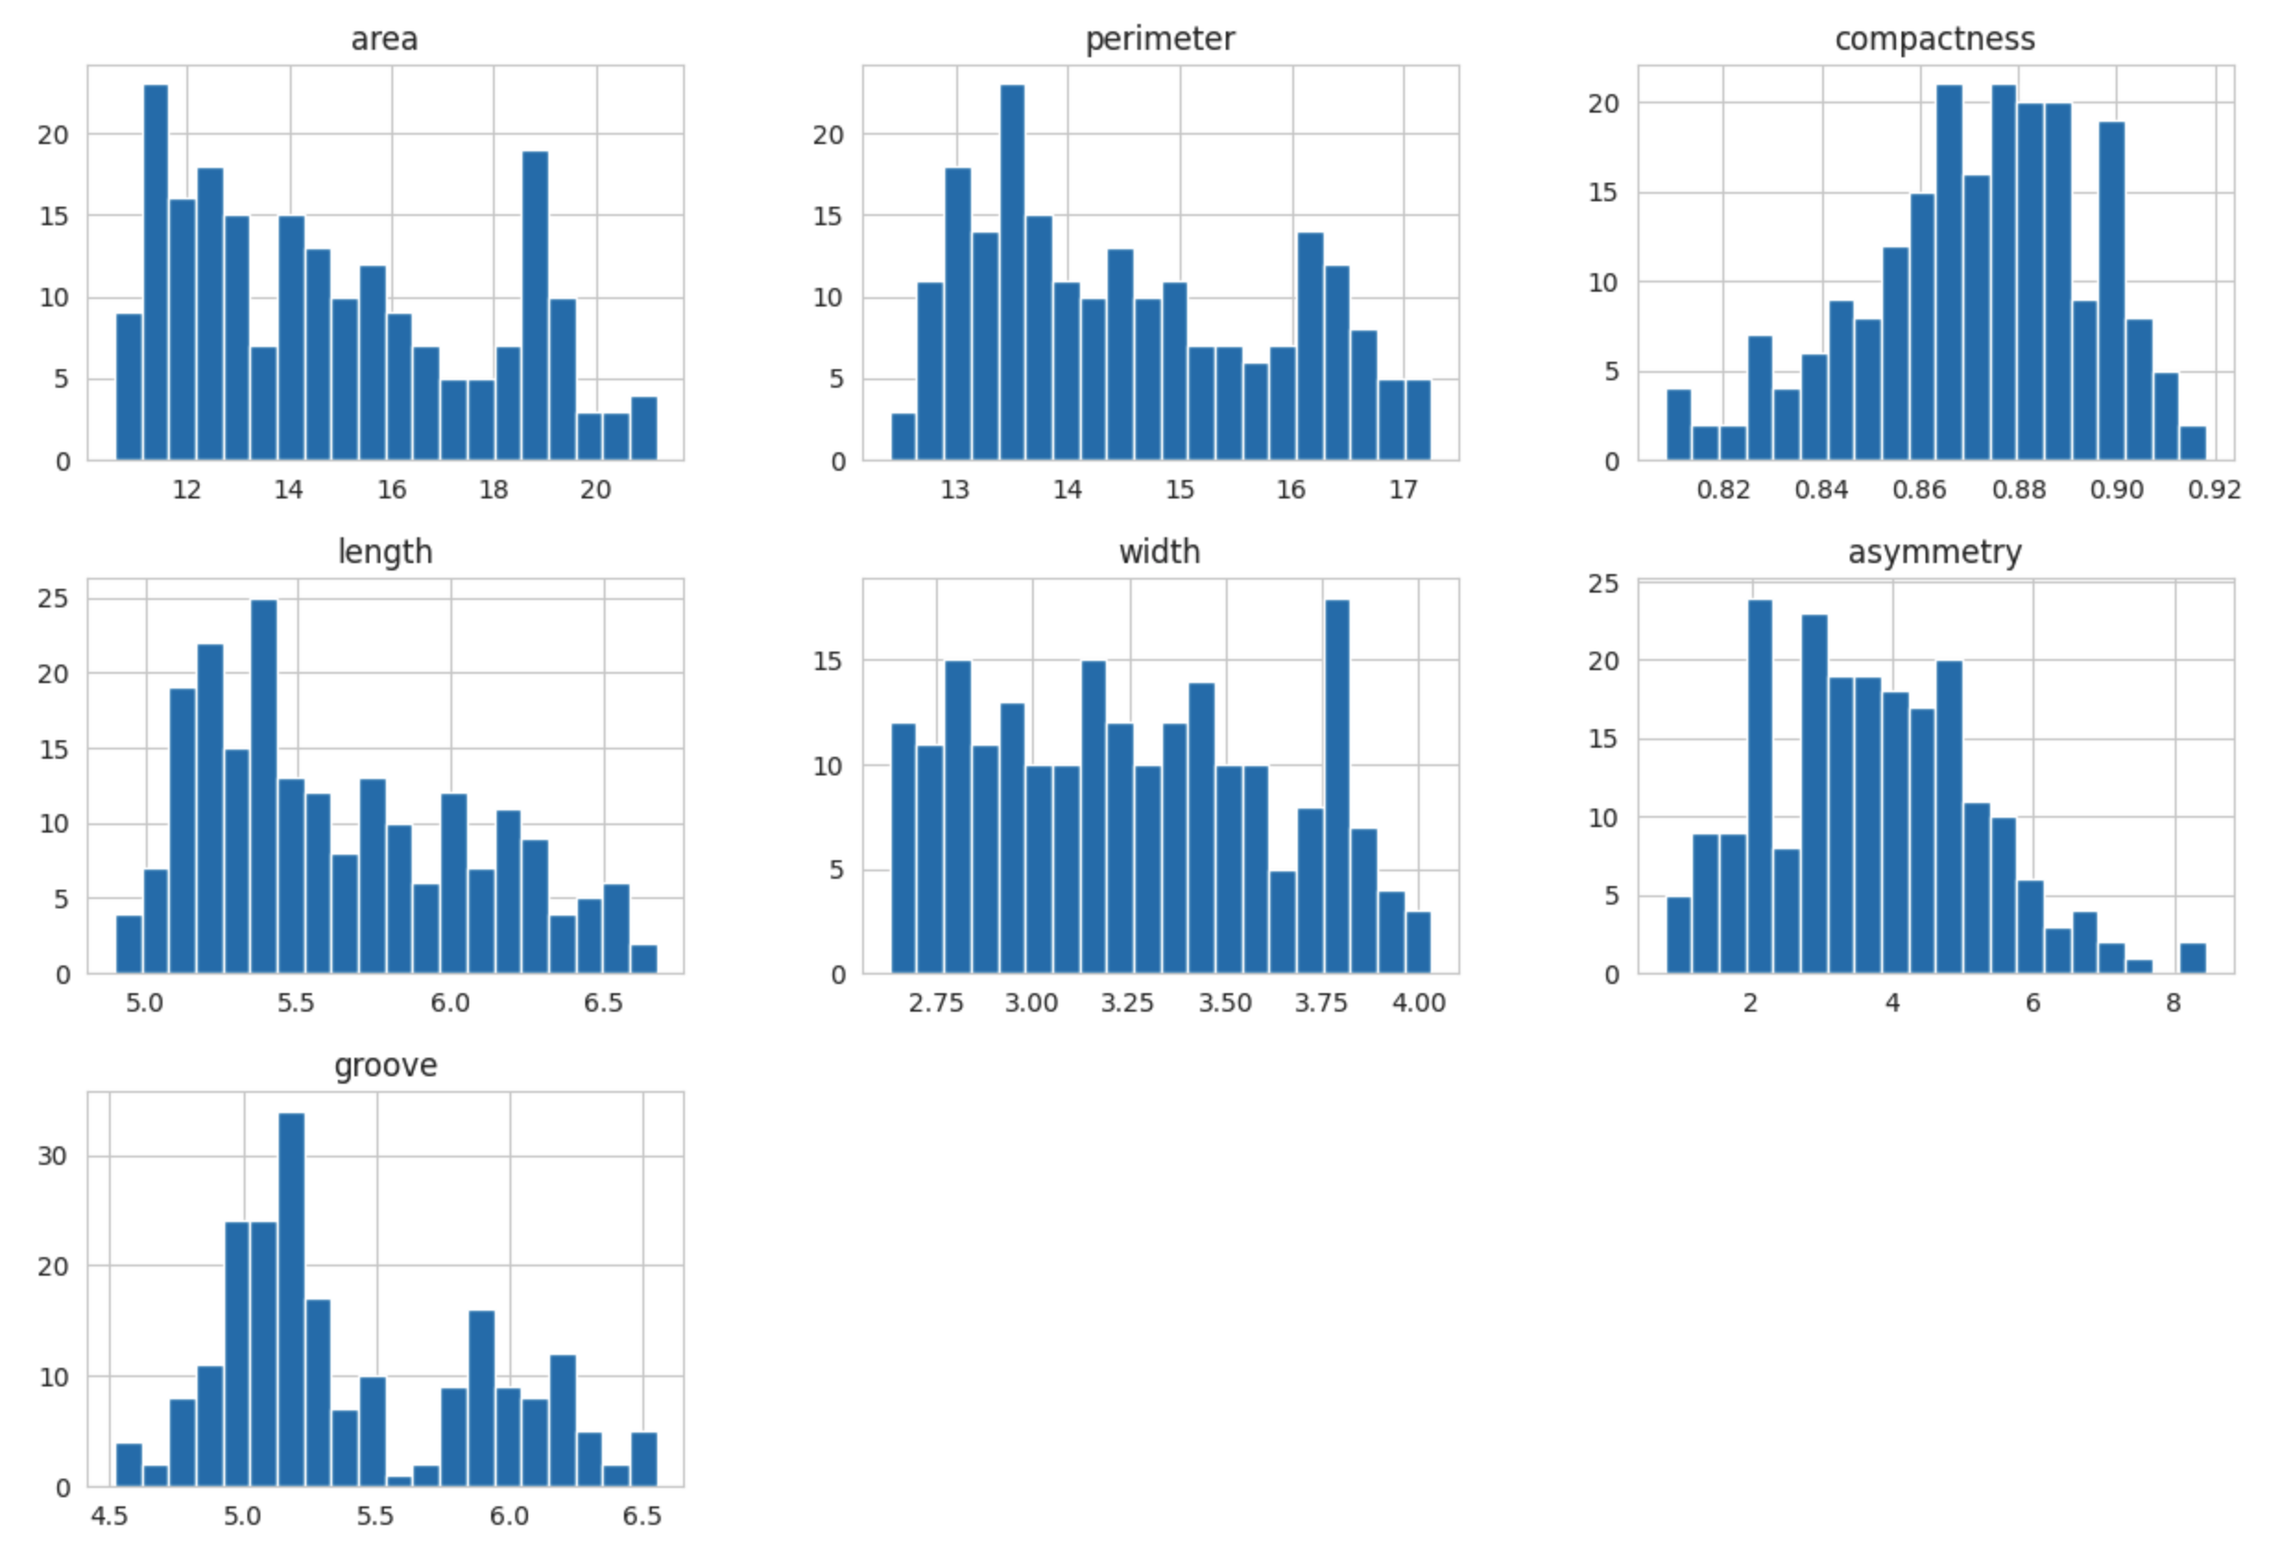
Histogram of Features

Slide 6
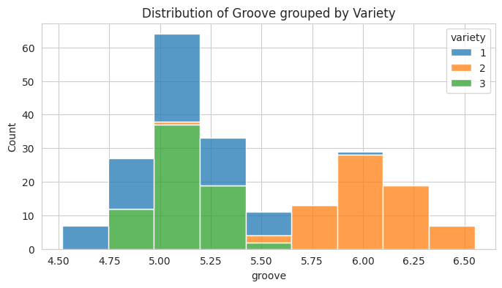
Histogram of Features

Slide 7
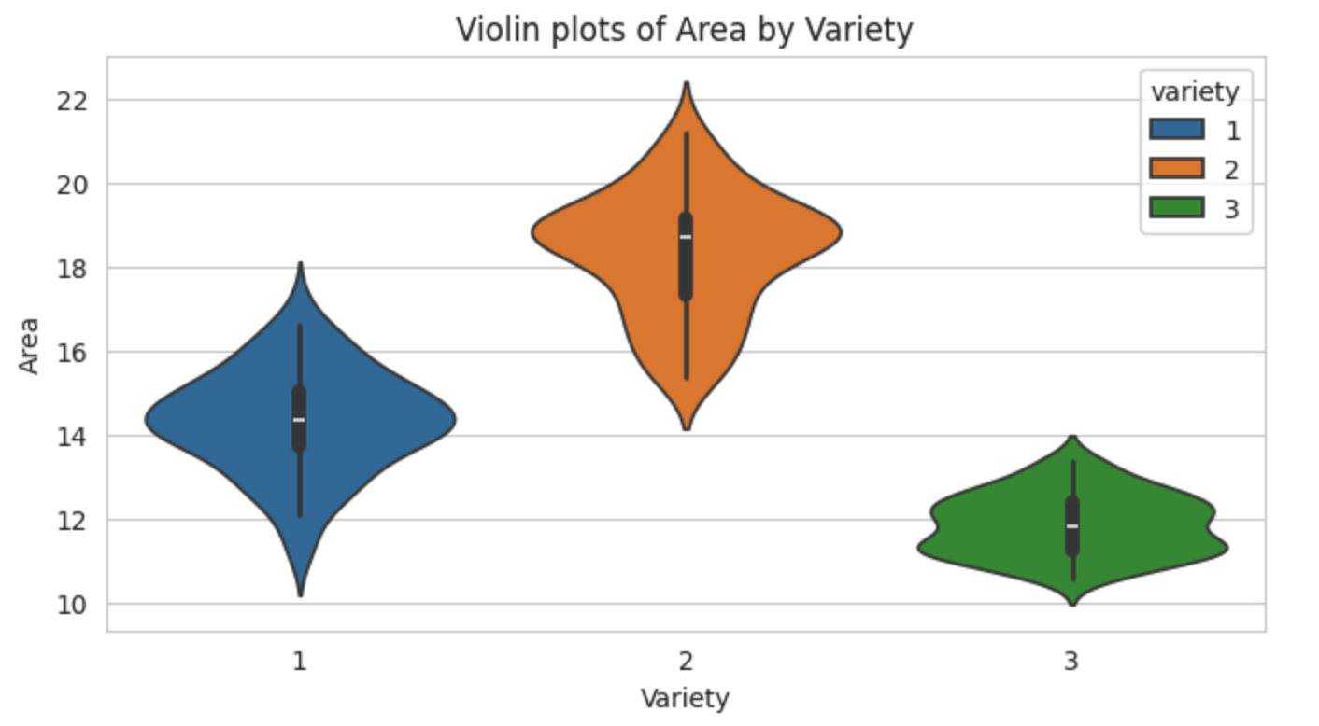
Violin Plot of Features

Slide 8
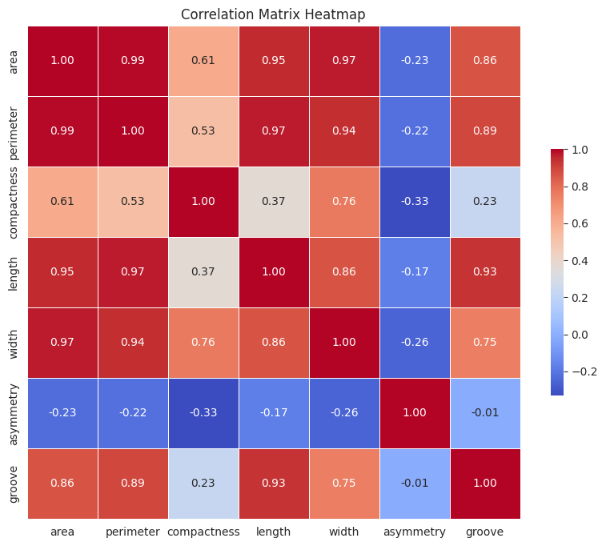
Correlation Between Features

Slide 9

Data Transformation
$$z= \frac{(x − μ)}{σ}$$

Slide 10
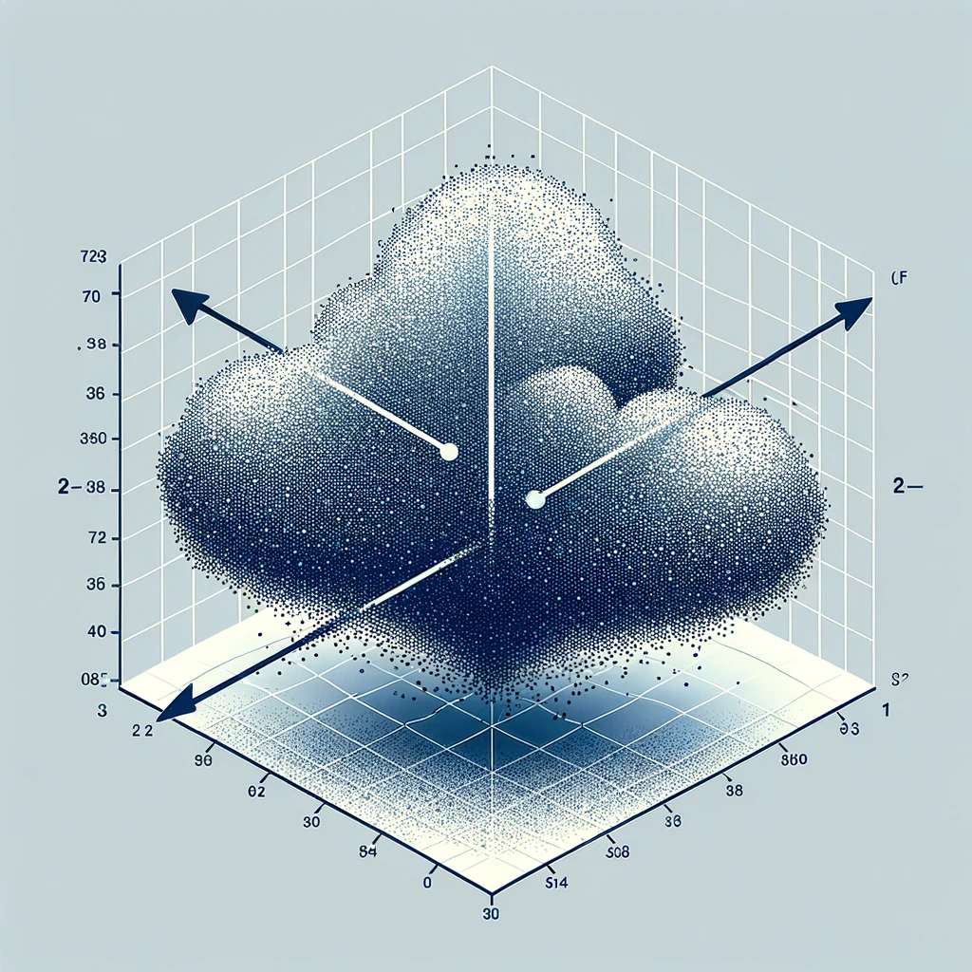
Principle Component Analysis
Target variance = 0.95
Reduced dataset used for both implementations of k-means

Slide 11
Elbow Plot Informed K-means Clustering

Slide 12
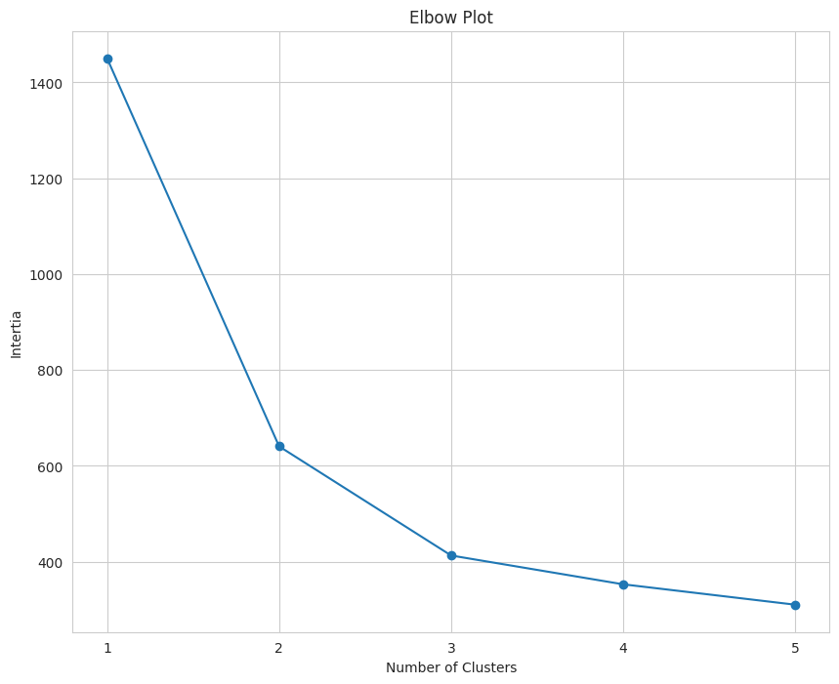
Elbow Plot

Slide 13
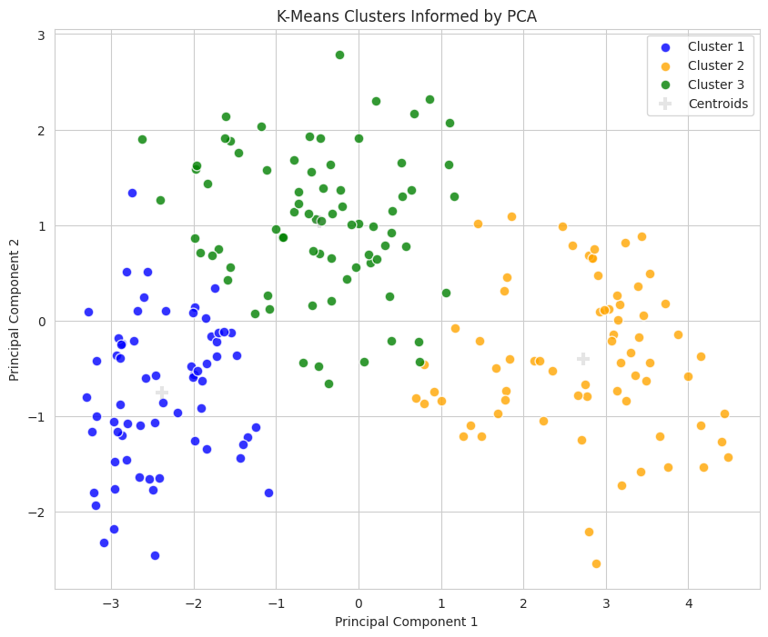
Plot of Clusters

Slide 14
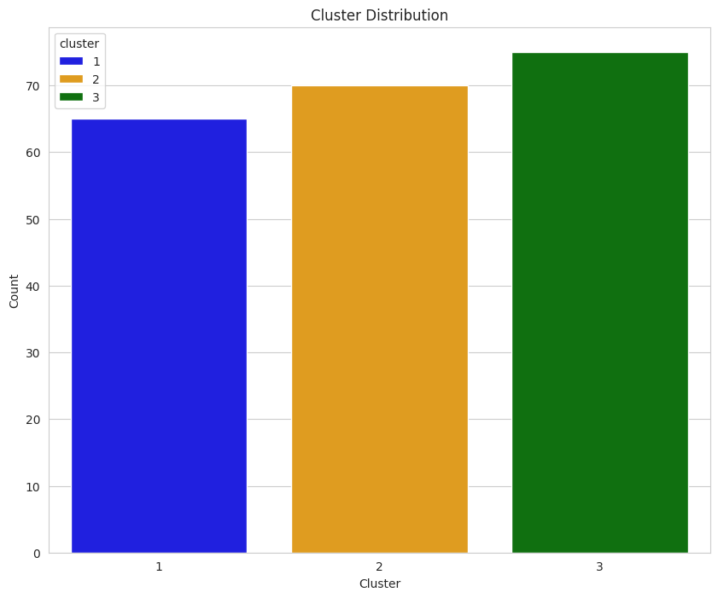
Size of Clusters
Cluster 1 = 65
Cluster 2 = 70
Cluster 3 = 75

Slide 15
Silhouette Score Informed K-means Clustering

Slide 16
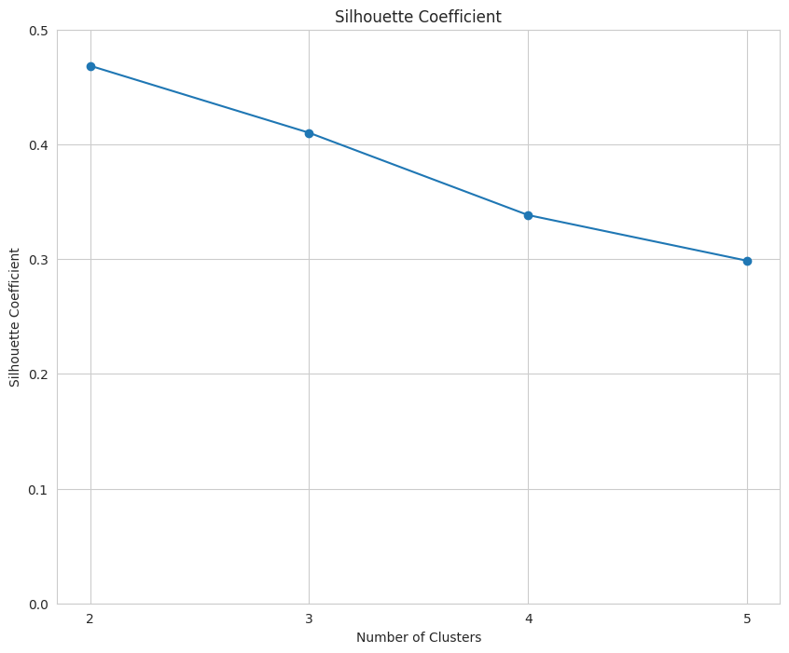
Silhouette Coefficient

Slide 17
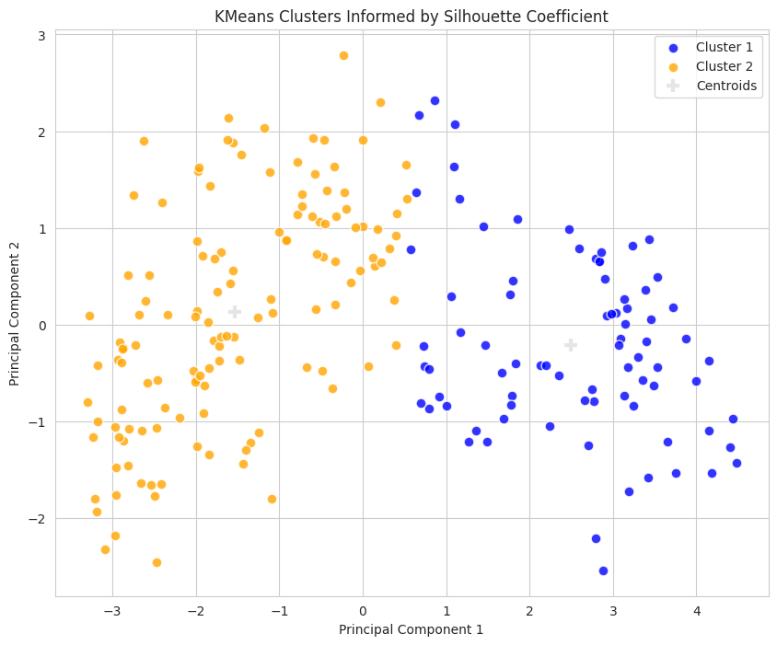
Plot of Clusters

Slide 18
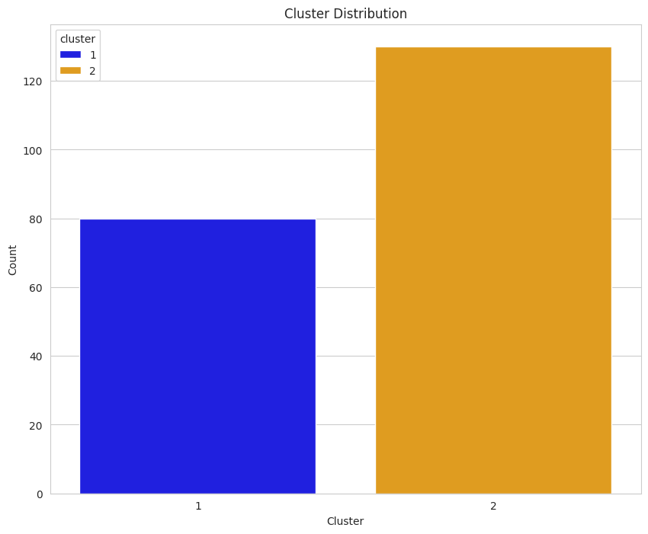
Size of Clusters
Cluster 1 = 80
Cluster 2 = 130

Slide 19
Comparison of K-means Algorithms

Slide 20
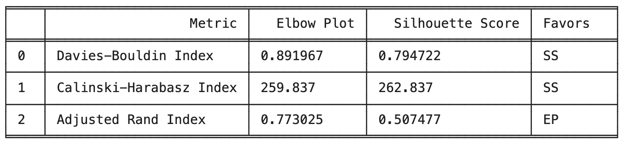
Evaluation Metrics
Two of three metrics favor K-means informed by Silhouette Score
Adjusted Rand Index incorporates ground truth

Slide 21
Conclusion

Slide 22
Conclusion
K-means informed by Elbow Plot performed better
Might be best to explore all options instead of relying on general suggestions
Future iterations of project could incorporate different dimension reduction techniques

